Slide 1
Interest Rate Futures
Chapter 6

Slide 2
Day Count Convention
Defines:
  the period of time to which the interest rate applies
  The period of time used to calculate accrued interest (relevant when the instrument is bought of sold)

Slide 3
Day Count Conventions in the U.S. (Page 136-137)
Treasury Bonds: | Actual/Actual (in period)
Corporate Bonds: | 30/360
Money Market Instruments: | Actual/360

Slide 4
Examples
Bond: 8% Actual/ Actual in period.
  4% is earned between coupon payment dates. Accruals on an Actual basis. When coupons are paid on March 1 and Sept 1, how much interest is earned between March 1 and April 1?
Bond: 8% 30/360
  Assumes 30 days per month and 360 days per year. When coupons are paid on March 1 and Sept 1, how much interest is earned between March 1 and April 1?

Slide 5
Examples continued
T-Bill: 8% Actual/360:
  8% is earned in 360 days. Accrual calculated by dividing the actual number of days in the period by 360. How much interest is earned between March 1 and April 1?

Slide 6
The February Effect (Business Snapshot 6.1, page 137)
How many days of interest are earned between February 28, 2017 and March 1, 2017 when
  day count is Actual/Actual in period?
  day count is 30/360?

Slide 7
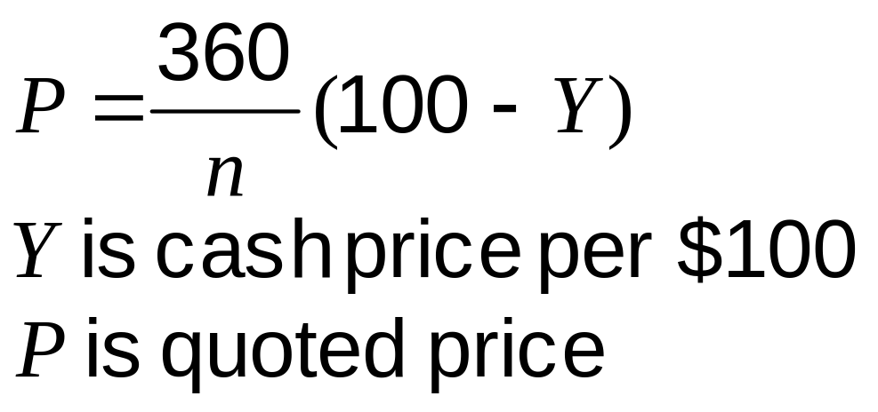
Treasury Bill Prices in the US

Slide 8
Treasury Bond Price Quotes in the U.S
Cash price = Quoted price +
Accrued Interest

Slide 9
Treasury Bond Futures
Pages 139-143
Cash price received by party with short position =
Most Recent Settlement Price × Conversion factor + Accrued interest

Slide 10
Example
Most recent settlement price = 90.00
Conversion factor of bond delivered = 1.3800
Accrued interest on bond =3.00
Price received for bond is 1.3800×90.00+3.00 = $127.20
per $100 of principal

Slide 11
Conversion Factor
The conversion factor for a bond is approximately equal to the value of the bond on the assumption that the yield curve is flat at 6% with semiannual compounding

Slide 12
CBOT
T-Bonds & T-Notes
Factors that affect the futures price:
  Delivery can be made any time during the delivery month
  Any of a range of eligible bonds can be delivered
  The wild card play

Slide 13
Eurodollar Futures (Pages 143-148)
A Eurodollar is a dollar deposited in a bank outside the United States
Eurodollar futures are futures on the 3-month Eurodollar deposit rate (same as 3-month LIBOR rate)
One contract is on the rate earned on $1 million
A change of one basis point or 0.01 in a Eurodollar futures quote corresponds to a contract price change of $25

Slide 14
Eurodollar Futures continued
A Eurodollar futures contract is settled in cash
When it expires (on the third Wednesday of the delivery month) the final settlement price is 100 minus the actual three month LIBOR rate

Slide 15
Example
Date | Quote
Nov 1 | 97.12
Nov 2 | 97.23
Nov 3 | 96.98
……. | ……
Dec 21 | 97.42

Slide 16
Example
Suppose you buy (take a long position in) a contract on November 1
The contract expires on December 21
The prices are as shown
How much do you gain or lose a) on the first day, b) on the second day, c) over the whole time until expiration?

Slide 17
Example continued
If on Nov. 1 you know that you will have $1 million to invest on for three months on Dec 21, the contract locks in a rate of
100 - 97.12 = 2.88%
In the example you earn 100 – 97.42 = 2.58% on $1 million for three months (=$6,450) and make a gain day by day on the futures contract of 30×$25 =$750

Slide 18
Formula for Contract Value (page 142)
If Q is the quoted price of a Eurodollar futures contract, the value of one contract is
10,000[100-0.25(100-Q)]
This corresponds to the $25 per basis point rule

Slide 19
Forward Rates and Eurodollar Futures (Page 147-148)
Eurodollar futures contracts last as long as 10 years
For Eurodollar futures lasting beyond two years we cannot assume that the forward rate equals the futures rate

Slide 20
There are Two Reasons
Futures is settled daily where forward is settled once
Futures is settled at the beginning of the underlying three-month period; FRA is settled at the end of the underlying three- month period

Slide 21
Forward Rates and Eurodollar Futures continued
A “convexity adjustment” often made is
Forward Rate = Futures Rate−0.5σ²T₁T₂
  T₁ is the start of period covered by the forward/futures rate
  T₂ is the end of period covered by the forward/futures rate (90 days later that T₁)
σ is the standard deviation of the change in the short rate per year

Slide 22
Convexity Adjustment when σ=0.012 (Example 6.4, page147)
Maturity of Futures | Convexity Adjustment (bps)
2 | 3.2
4 | 12.2
6 | 27.0
8 | 47.5
10 | 73.8

Slide 23
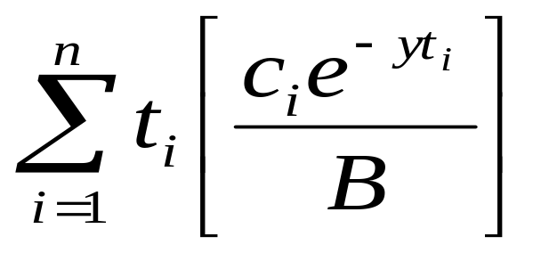
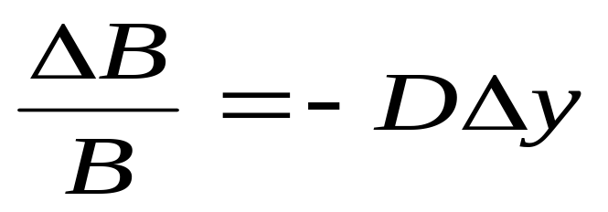
Duration (page 148-152)
Duration of a bond that provides cash flow c_{i} at time t_{i} is
where B is its price and y is its yield (continuously compounded)
This leads to

Slide 24
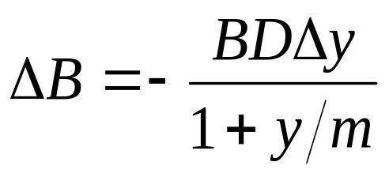
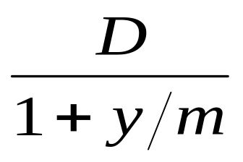
Duration Continued
When the yield y is expressed with compounding m times per year
The expression
is referred to as the “modified duration”

Slide 25
Duration Matching
This involves hedging against interest rate risk by matching the durations of assets and liabilities
It provides protection against small parallel shifts in the zero curve

Slide 26
Use of Eurodollar Futures
One contract locks in an interest rate on $1 million for a future 3-month period
How many contracts are necessary to lock in an interest rate on $1 million for a future six-month period?

Slide 27
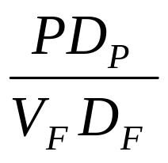
Duration-Based Hedge Ratio
V_{F} | Contract Price for Interest Rate Futures
D_{F} | Duration of Asset Underlying Futures at Maturity
P | Value of portfolio being Hedged
D_{P} | Duration of Portfolio at Hedge Maturity

Slide 28
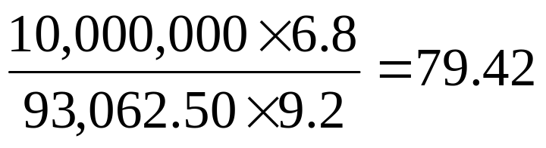
Example (page 153-154)
Three month hedge is required for a $10 million portfolio. Duration of the portfolio in 3 months will be 6.8 years.
3-month T-bond futures price is 93-02 so that contract price is $93,062.50
Duration of cheapest to deliver bond in 3 months is 9.2 years
Number of contracts for a 3-month hedge is

Slide 29
Limitations of Duration-Based Hedging
Assumes that only parallel shift in yield curve take place
Assumes that yield curve changes are small
When T-Bond futures is used assumes there will be no change in the cheapest-to-deliver bond

Slide 30
GAP Management (Business Snapshot 6.3, page 152)
This is a more sophisticated approach used by financial institutions to hedge interest rates. It involves
  Bucketing the zero curve
  Hedging exposure to situation where rates corresponding to one bucket change and all other rates stay the same

